Slide 1
uGEMM: Unary Computing Architecture
for GEMM Applications
Di Wu, Jingjie Li, Ruokai Yin, Hsuan Hsiao (University of Toronto), Younghyun Kim and Joshua San Miguel

Slide 2
Executive Summary
Review the demand of energy-efficient GEMM implementations, and motivate uGEMM over other unary approaches.
Demonstrate uGEMM’s compatibility for arbitrarily encoded inputs for multiplication and addition mathematically.
Prove the knob of uGEMM’s high energy efficiency to be early termination enabled by high accuracy and stability.
Notes:
Provide more high level take aways.
Emph GEMM.
Goal of uGEMM: energy effieccnt, high acc, high stab, early term, compatible.

Slide 3
Outline
Background
Motivation
Architecture
Evaluation

Slide 4
GEneral Matrix Multiply (GEMM)
Ubiquitous in applications
Computer vision
Signal processing
Machine learning
“At the center of Deep Learning”
95% of GPU runtime
89% of CPU runtime
Energy efficiency
Unary computing as salvation
Y. Jia, “Learning Semantic Image Representations at a Large Scale,” PhD thesis.
Notes:
Remove animation about binary

Slide 5
Computing paradigm
Paradigm |  | Data | Bit significance | Computing domain
Binary computing | Bit parallel | Parallel | Varying | Spatial
 | Bit serial
Unary computing
s
a
b
s
a
b
s
a
b
s
a
b
FA
FA
FA
FA
co
ci
co
ci
co
ci
co
ci
0
Notes:
Remove animation about binary

Slide 6
Computing paradigm
Paradigm |  | Data | Bit significance | Computing domain
Binary computing | Bit parallel | Parallel | Varying | Spatial
 | Bit serial | Serial | Varying | Temporal
Unary computing
s
a
b
FA
co
ci
DFF

Slide 7
Computing paradigm
Paradigm |  | Data | Bit significance | Computing domain
Binary computing | Bit parallel | Parallel | Varying | Spatial
 | Bit serial | Serial | Varying | Temporal
Unary computing |  | Serial | Equal | Temporal
16 bits
0100 1000 0010 0010
Unary Add
1100 1010 1010 0010
1101 0110 1010 1011
Notes:
Black box add, non scale is good
Highlighting the data encoding method: weighted or not
Remove commers, using space

Slide 8
Unary computing scheme
Scheme | Bit stream | Application
Stochastic computing | Rate coding | LDPC, image processing, machine learning
Race logic
Bit stream as data.
Probability of 1s matters only.
1101 1000 1010 1010
8 1s
…8888
SRC
CMP
…1010
Randomly determined
…3819
RNG
Notes:
Randomly determined with a prob
Make bit-level animation more comphrehensive

Slide 9
Unary computing scheme
Scheme | Bit stream | Application
Stochastic computing | Rate coding | LDPC, image processing, machine learning
Race logic | Temporal coding | DNA sequencing, decision tree, sorting
Bit stream as data.
Delay of 1s matters only.
0000 0000 1111 1111
8 1s
…8888
SRC
CMP
…1111
Deterministically determined
…3210
CNT
Notes:
deterministicly determined with a prob
state that no coding will be mentioned till eval

Slide 10
Unary computing data – bit stream
Polarity | Binary width | Unary length | Probability of 1s | Value | Range
Unipolar | N | 2^N | P(1) | P(1) | Unsigned, [0, 1]
Bipolar
1101 1000 1010 1010
8 1s
Unipolar value=0.5
Notes:
Make bit-level animation more comphrehensive

Slide 11
Unary computing data – bit stream
Polarity | Binary width | Unary length | Probability of 1s | Value | Range
Unipolar | N | 2^N | P(1) | P(1) | Unsigned, [0, 1]
Bipolar |  |  |  | 2*P(1)-1 | Signed, [-1, 1]
1101 1000 1010 1010
8 1s
Bipolar value=0.0
Notes:
State unipolar is always used in following slides

Slide 12
Measure of bit streams
Metric | Bit stream | Goal
Correlation | Two | How similar two bit streams are.
Stability
1101 1000 1010 1010
8 1s
+1 correlation: count of aligned 1s is maximized.
Aligned 1 count: 8
1101 1000 1010 1010
8 1s
Expected in temporal coding
Notes:
+1 correlation first
More animations for aligned 1s.
And a 0 correlation, indepenance
-1 last
Use two bit streams
Remove the table snapshot?
Range and which is prefered

Slide 13
Measure of bit streams
Metric | Bit stream | Goal
Correlation | Two | How similar two bit streams are.
Stability
1101 1000 1010 1010
8 1s
+1 correlation: count of aligned 1s is maximized.
Aligned 1 count: 8
1101 1000 1010 1010
8 1s
1101 1000 1010 1010
8 1s
0 correlation: count of aligned 1s is balanced.
Aligned 1 count: 4
1110 0100 0101 1010
8 1s
Expected in rate coding
Notes:
+1 correlation first
More animations for aligned 1s.
And a 0 correlation, indepenance
-1 last
Use two bit streams
Remove the table snapshot?
Range and which is prefered

Slide 14
Measure of bit streams
Metric | Bit stream | Goal
Correlation | Two | How similar two bit streams are.
Stability
1101 1000 1010 1010
8 1s
+1 correlation: count of aligned 1s is maximized.
Aligned 1 count: 8
1101 1000 1010 1010
8 1s
1101 1000 1010 1010
8 1s
0 correlation: count of aligned 1s is balanced.
Aligned 1 count: 4
1110 0100 0101 1010
8 1s
1101 1000 1010 1010
8 1s
-1 correlation: count of aligned 1s is minimized.
Aligned 1 count: 0
0010 0111 0101 0101
8 1s
Notes:
+1 correlation first
More animations for aligned 1s.
And a 0 correlation, indepenance
-1 last
Use two bit streams
Remove the table snapshot?
Range and which is prefered

Slide 15
Measure of bit streams
Metric | Bit stream | Goal
Correlation | Two | How similar two bit streams are.
Stability | One | How fast a bit stream converges to its desired value.
1101 1000 1010 1010
8 1s
Cycle 7
Stability = 1-(7-1)/16 = 0.625
Stable point:
Error never exceeds a given threshold from now on.
Stability:
Ratio of stable cycle count to all.

Slide 16
Measure of bit streams
Metric | Bit stream | Goal
Correlation | Two | How similar two bit streams are.
Stability | One | How fast a bit stream converges to its desired value.
1101 1000 1010 1010
8 1s
Cycle 7
Stability = 1-(7-1)/16 = 0.625
Stable point:
Error never exceeds a given threshold from now on.
Stability:
Ratio of stable cycle count to all.
1010 1010 1010 1010
8 1s
Cycle 4
Stability = 1-(4-1)/16 = 0.8125

Slide 17
Measure of bit streams
Metric | Bit stream | Goal
Correlation | Two | How similar two bit streams are.
Stability | One | How fast a bit stream converges to its desired value.
1101 1000 1010 1010
8 1s
Cycle 7
Stability = 1-(7-1)/16 = 0.625
Stable point:
Error never exceeds a given threshold from now on.
Stability:
Ratio of stable cycle count to all.
High stability enables early termination.
1010 1010 1010 1010
8 1s
Cycle 4
Stability = 1-(4-1)/16 = 0.8125

Slide 18
Outline
Background
Motivation
Architecture
Evaluation

Slide 19
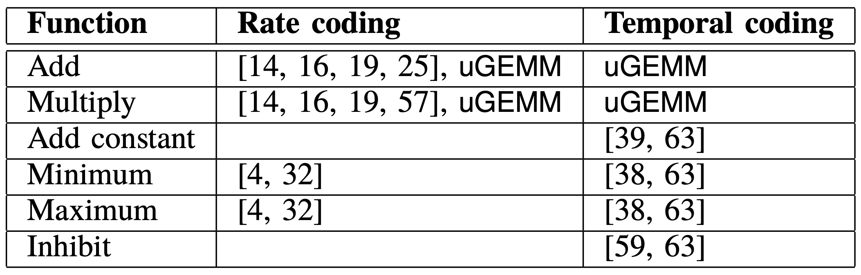
Unified uGEMM
Unified unary General Matrix Multiplication
First to support Add/Mul in temporal coding
Notes:
Compatibility for rate and temporal coding: support for all kinds of adders; add/mul insensitive to encoding.
Early termination: streaming, high acc, high stab

Slide 20
Unified uGEMM
Unified unary General Matrix Multiplication
First to support Add/Mul in temporal coding
Compatibility for varying coding and polarity
Notes:
Compatibility for rate and temporal coding: support for all kinds of adders; add/mul insensitive to encoding.
Early termination: streaming, high acc, high stab

Slide 21
Unified uGEMM
Unified unary General Matrix Multiplication
First to support Add/Mul in temporal coding
Compatibility for varying coding and polarity
Early termination
Fully streaming computation

Slide 22
Unified uGEMM
Unified unary General Matrix Multiplication
First to support Add/Mul in temporal coding
Compatibility for varying coding and polarity
Early termination
Fully streaming computation
High accuracy and stability by solving the correlation problem

Slide 23
Outline
Background
Motivation
Architecture
Evaluation

Slide 24
uGEMM overview
Multiplication
uMUL
Unipolar and Bipolar
Addition
Scaled (uSADD)
Unipolar and Bipolar
Non-Scaled (uNSADD)
Unipolar and Bipolar (first support)
Notes:
Overview of those units that leads to ugemm arch\
Mul ahead of add
Move example ahead of this intro.

Slide 25
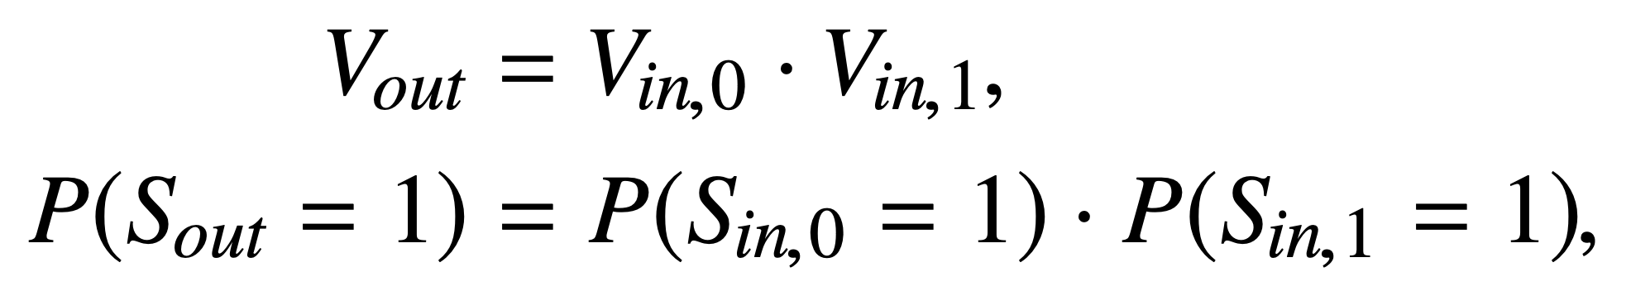
uGEMM – Multiplication
uMUL: unipolar
Expected function

Slide 26
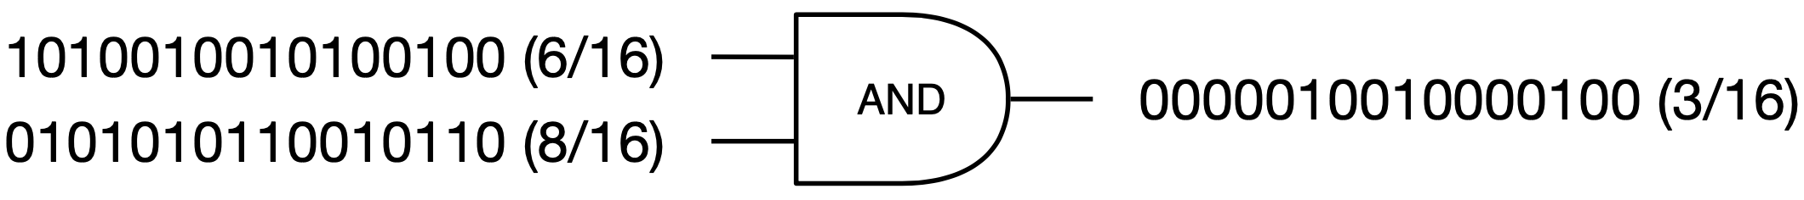
uGEMM – Multiplication
uMUL: unipolar
Expected function
Actual AND gate function

Slide 27
uGEMM – Multiplication
uMUL: unipolar
Expected function
Actual AND gate function
Correct with 0 correlation:
Marginal prob = conditional prob
3/16
6/16
8/16=0.5
3/6 = 0.5
Notes:
Do you really need the equation to explain this? Just AND gate circuit should be enough.

Slide 28
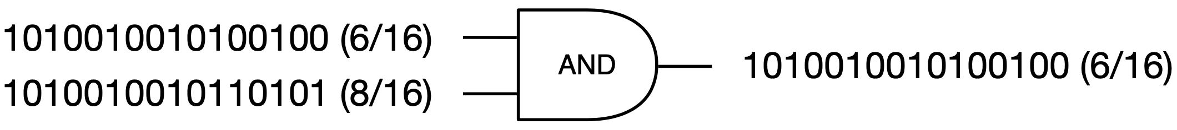
uGEMM – Multiplication
uMUL: unipolar
Expected function
Actual AND gate function
Correct with 0 correlation:
Marginal prob = conditional prob
3/16
6/16
8/16=0.5
Wrong with non-0 correlation:
Marginal prob != conditional prob
6/6 = 1.0

Slide 29
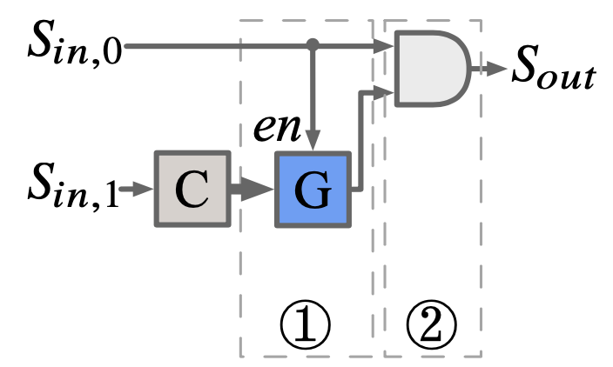
uGEMM – Multiplication
uMUL: unipolar
Conditional bit stream generation
Enforce P(S_{in, 1}=1) = P(S_{in, 1}=1| S_{in, 0}=1)
SRC
CMP
RNG
en
C: Counter
G: Bit stream generator
Notes:
Make a new slide for the counter and bit stream generator on right. Highlight takeaway from prev slide in bullet points maybe?

Slide 30
uGEMM – Multiplication
uMUL: unipolar
2/4: 1 0 0 1
0 0 0 1
S_{in,1} is static in counter.
2/4
2
1
2/4*2/4=1/4
Cycle | Counter (C) | RNG (G) | AND 0 (In 0) | AND 1 | Output
1 | 2 | 1 | 1 | 1 | 1
2
3
4
>

Slide 31
uGEMM – Multiplication
uMUL: unipolar
2/4: 1 0 0 1
0 0 0 1
S_{in,1} is static in counter.
2/4
2
3
2/4*2/4=1/4
Cycle | Counter (C) | RNG (G) | AND 0 (In 0) | AND 1 | Output
1 | 2 | 1 | 1 | 1 | 1
2 | 2 | 3 | 0 | 0 | 0
3
4
en
<

Slide 32
uGEMM – Multiplication
uMUL: unipolar
2/4: 1 0 0 1
0 0 0 1
S_{in,1} is static in counter.
2/4
2
3
2/4*2/4=1/4
Cycle | Counter (C) | RNG (G) | AND 0 (In 0) | AND 1 | Output
1 | 2 | 1 | 1 | 1 | 1
2 | 2 | 3 | 0 | 0 | 0
3 | 2 | 3 | 0 | 0 | 0
4
<

Slide 33
uGEMM – Multiplication
uMUL: unipolar
2/4: 1 0 0 1
0 0 0 1
S_{in,1} is static in counter.
2/4
2
3
2/4*2/4=1/4
Cycle | Counter (C) | RNG (G) | AND 0 (In 0) | AND 1 | Output
1 | 2 | 1 | 1 | 1 | 1
2 | 2 | 3 | 0 | 0 | 0
3 | 2 | 3 | 0 | 0 | 0
4 | 2 | 3 | 1 | 0 | 0
<

Slide 34
uGEMM – Multiplication
uMUL: unipolar
2/4: 1 0 0 1
0 0 0 1
S_{in,1} is static in counter.
2/4
2/4*2/4=1/4
Cycle | Counter (C) | RNG (G) | AND 0 (In 0) | AND 1 | Output
1 | 2 | 1 | 1 | 1 | 1
2 | 2 | 3 | 0 | 0 | 0
3 | 2 | 3 | 0 | 0 | 0
4 | 2 | 3 | 1 | 0 | 0
1/4

Slide 35
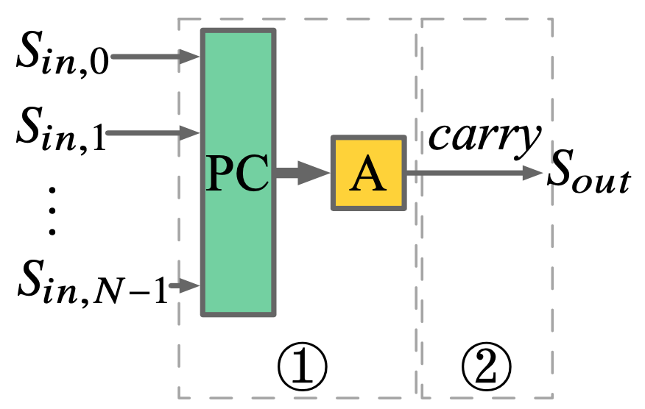
uGEMM – Scaled addition
uSADD: unipolar
4
3/4: 0 1 1 1
0
2/4: 0 1 0 1
1 0 0 1
1/4: 0 0 0 1
2/4: 1 0 0 1
(3/4+2/4+1/4+2/4)/4=2/4
Cycle | Input count (PC) | Accumulator (A) | Carry (output)
1 | 4 | 0 | 1
2
3
4
Notes:
Move the equations to the right of this slides

Slide 36
uGEMM – Scaled addition
uSADD: unipolar
1
3/4: 0 1 1 1
1
2/4: 0 1 0 1
1 0 0 1
1/4: 0 0 0 1
2/4: 1 0 0 1
(3/4+2/4+1/4+2/4)/4=2/4
Cycle | Input count (PC) | Accumulator (A) | Carry (output)
1 | 4 | 0 | 1
2 | 1 | 1 | 0
3
4
+

Slide 37
uGEMM – Scaled addition
uSADD: unipolar
2
3/4: 0 1 1 1
3
2/4: 0 1 0 1
1 0 0 1
1/4: 0 0 0 1
2/4: 1 0 0 1
(3/4+2/4+1/4+2/4)/4=2/4
Cycle | Input count (PC) | Accumulator (A) | Carry (output)
1 | 4 | 0 | 1
2 | 1 | 1 | 0
3 | 2 | 3 | 0
4
+

Slide 38
uGEMM – Scaled addition
uSADD: unipolar
1
3/4: 0 1 1 1
0
2/4: 0 1 0 1
1 0 0 1
1/4: 0 0 0 1
2/4: 1 0 0 1
(3/4+2/4+1/4+2/4)/4=2/4
Cycle | Input count (PC) | Accumulator (A) | Carry (output)
1 | 4 | 0 | 1
2 | 1 | 1 | 0
3 | 2 | 3 | 0
4 | 1 | 0 | 1
+

Slide 39
uGEMM – Scaled addition
uSADD: unipolar
3/4: 0 1 1 1
2/4: 0 1 0 1
1 0 0 1
1/4: 0 0 0 1
2/4: 1 0 0 1
(3/4+2/4+1/4+2/4)/4=2/4
Cycle | Input count (PC) | Accumulator (A) | Carry (output)
1 | 4 | 0 | 1
2 | 1 | 1 | 0
3 | 2 | 3 | 0
4 | 1 | 0 | 1
2/4

Slide 40
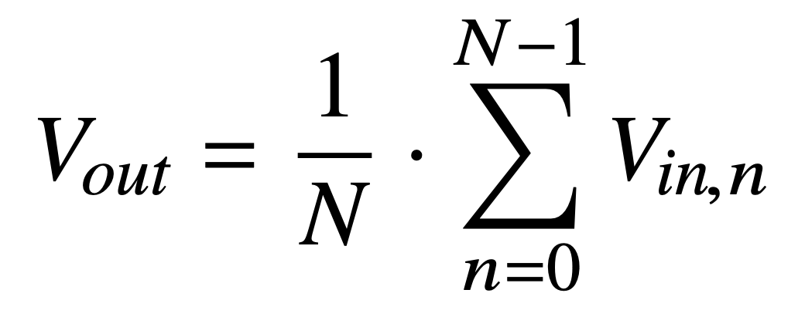
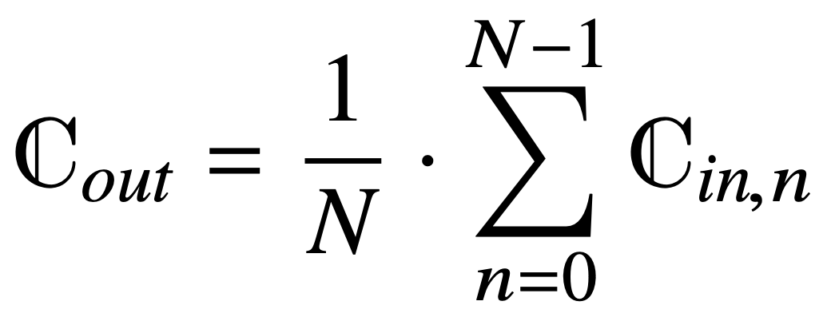
uGEMM – Scaled addition
uSADD
Expected function
Carry overflow mechanism
Parallel counter (PC) records current input.
When accumulation (A) overflows, output logic 1.
Notes:
Overview of those units that leads to ugemm arch\
Mul ahead of add
Move example ahead of this intro.

Slide 41
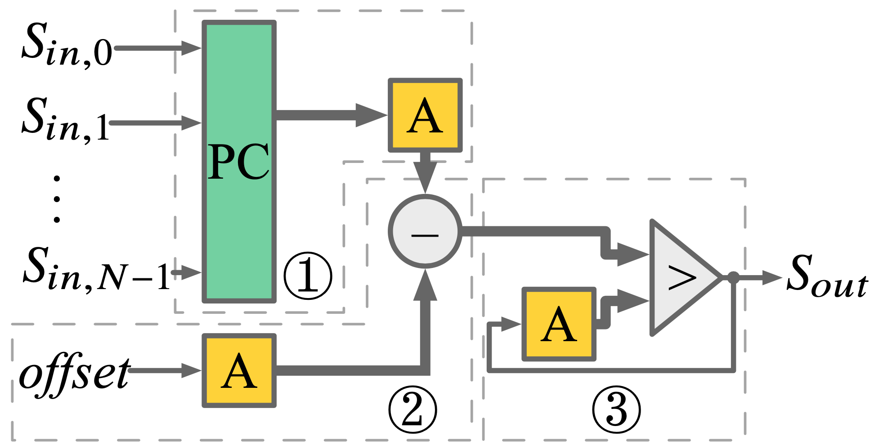
uGEMM – Non-scaled addition
uNSADD: unipolar
4
3/4: 0 1 1 1
4
2/4: 0 1 0 1
1/4: 0 0 0 1
Anticipated
2/4: 1 0 0 1
1 1 1 1
Historical
0
0
Clip(3/4+2/4+1/4+2/4)=1
Cycle | Input count (PC) | Acc (1) | Acc (3) | Acc (1>3) | Output
1 | 4 | 4 | 0 | True | 1
2
3
4
Notes:
Remove offset in table and diagram

Slide 42
uGEMM – Non-scaled addition
uNSADD: unipolar
1
3/4: 0 1 1 1
5
2/4: 0 1 0 1
1/4: 0 0 0 1
2/4: 1 0 0 1
1 1 1 1
1
0
Clip(3/4+2/4+1/4+2/4)=1
Cycle | Input count (PC) | Acc (1) | Acc (3) | Acc (1>3) | Output
1 | 4 | 4 | 0 | True | 1
2 | 1 | 5 | 1 | True | 1
3
4
+

Slide 43
uGEMM – Non-scaled addition
uNSADD: unipolar
2
3/4: 0 1 1 1
7
2/4: 0 1 0 1
1/4: 0 0 0 1
2/4: 1 0 0 1
1 1 1 1
2
0
Clip(3/4+2/4+1/4+2/4)=1
Cycle | Input count (PC) | Acc (1) | Acc (3) | Acc (1>3) | Output
1 | 4 | 4 | 0 | True | 1
2 | 1 | 5 | 1 | True | 1
3 | 2 | 7 | 2 | True | 1
4
+

Slide 44
uGEMM – Non-scaled addition
uNSADD: unipolar
1
3/4: 0 1 1 1
8
2/4: 0 1 0 1
1/4: 0 0 0 1
2/4: 1 0 0 1
1 1 1 1
3
0
Clip(3/4+2/4+1/4+2/4)=1
Cycle | Input count (PC) | Acc (1) | Acc (3) | Acc (1>3) | Output
1 | 4 | 4 | 0 | True | 1
2 | 1 | 5 | 1 | True | 1
3 | 2 | 7 | 2 | True | 1
4 | 1 | 8 | 3 | True | 1
+

Slide 45
uGEMM – Non-scaled addition
uNSADD: unipolar
3/4: 0 1 1 1
2/4: 0 1 0 1
1/4: 0 0 0 1
2/4: 1 0 0 1
1 1 1 1
Clip(3/4+2/4+1/4+2/4)=1
Cycle | Input count (PC) | Acc (1) | Acc (3) | Acc (1>3) | Output
1 | 4 | 4 | 0 | True | 1
2 | 1 | 5 | 1 | True | 1
3 | 2 | 7 | 2 | True | 1
4 | 1 | 8 | 3 | True | 1
4/4

Slide 46
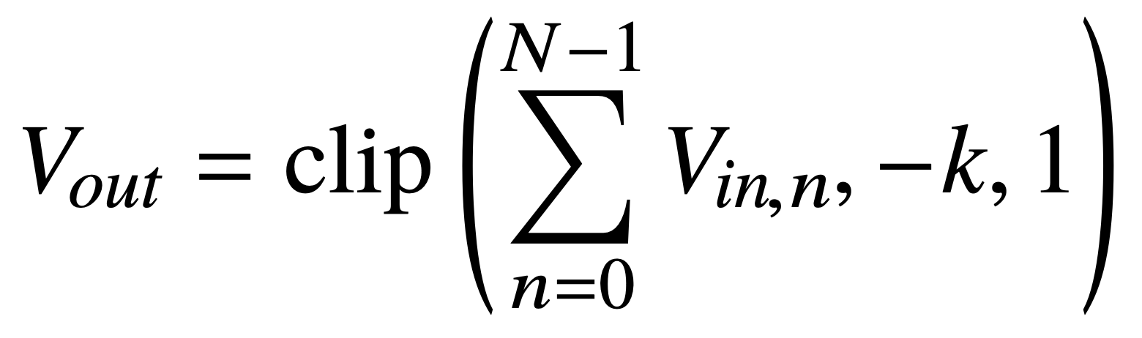

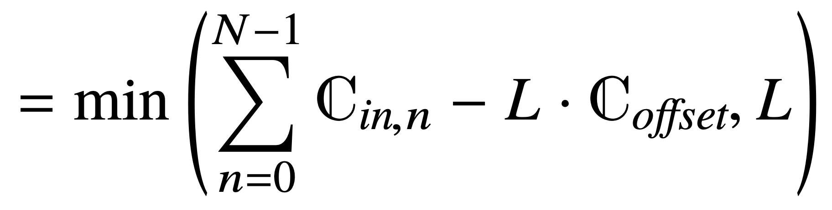
uGEMM – Non-scaled addition
uNSADD
Expected function
Output tracking mechanism
Difference between anticipated and historical output 1s indicates what to output.
Anticipated
Historical

Slide 47
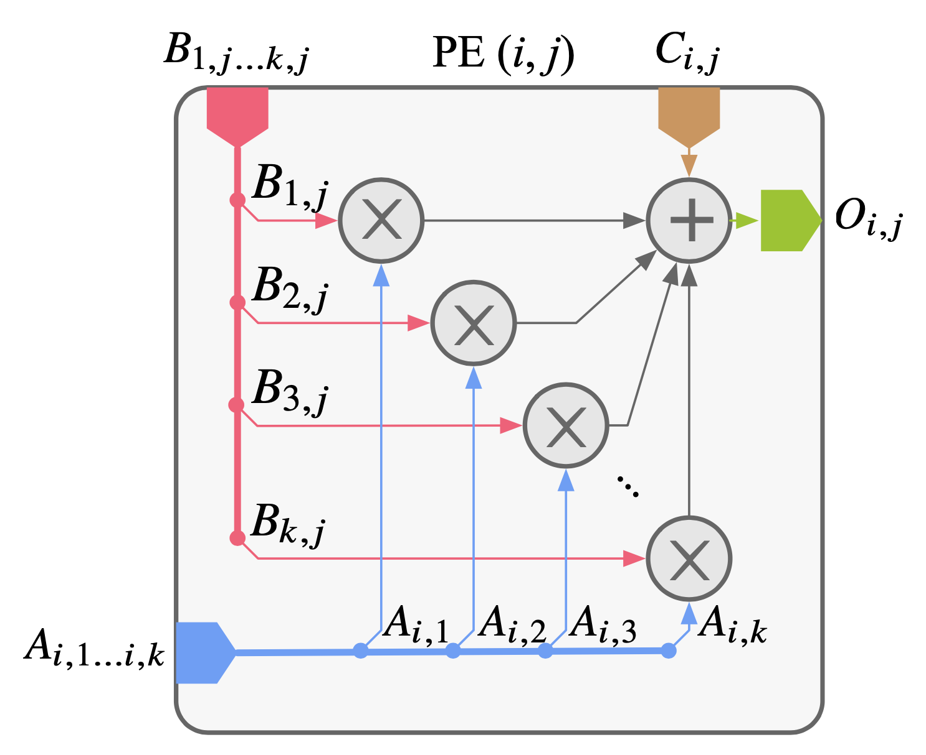
uGEMM – Processing element
Input insensitivity
Multiplication
Generating operand conditionally
Ignoring correlation

Slide 48
uGEMM – Processing element
Input insensitivity
Multiplication
Generating operand conditionally
Ignoring correlation
Addition
Caring about bit count
Ignoring bit distribution

Slide 49
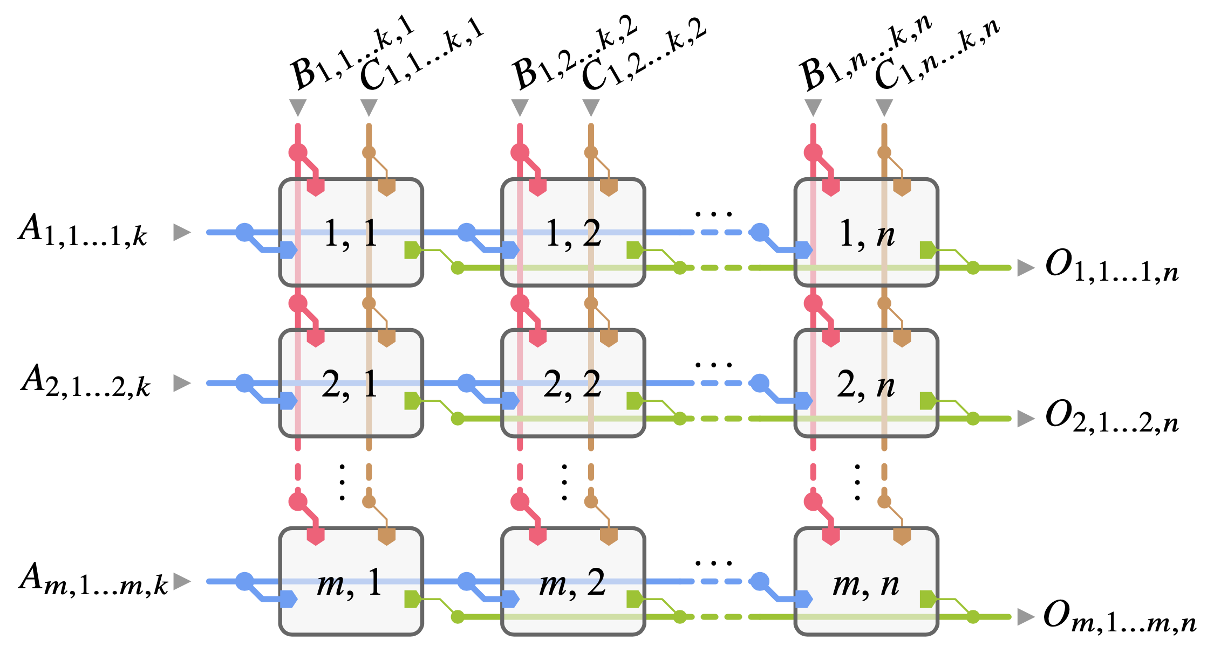
uGEMM – PE array
High parallelism via broadcasting
Input insensitivity due to PE
Reliable early termination
Fully streaming computation
High accuracy and stability
Notes:
I didn't completely get what you mean by "fully streaming"?

Slide 50
Outline
Background
Motivation
Architecture
Evaluation

Slide 51
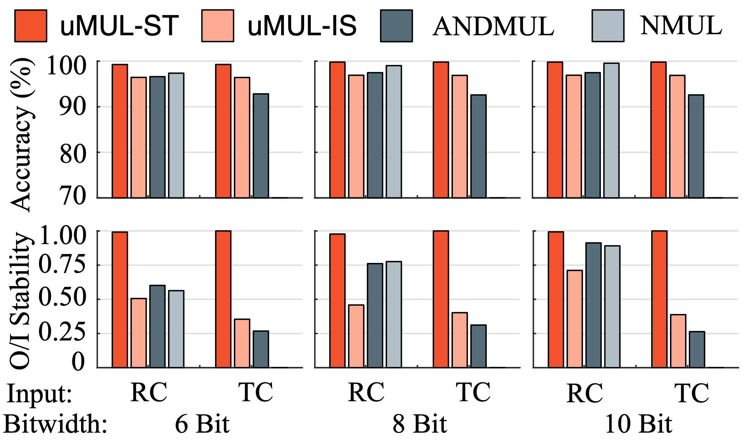
uMUL performance: Unipolar
Accurate final result
Static input (ST)
In-stream input (IS)
Faster stabilization
Output/Input stability
Input insensitivity
Rate coding (RC)
Temporal coding (TC)
Notes:
The font on figures is small. Maybe just regenerate a graph with bigger font just for ppt.

Slide 52
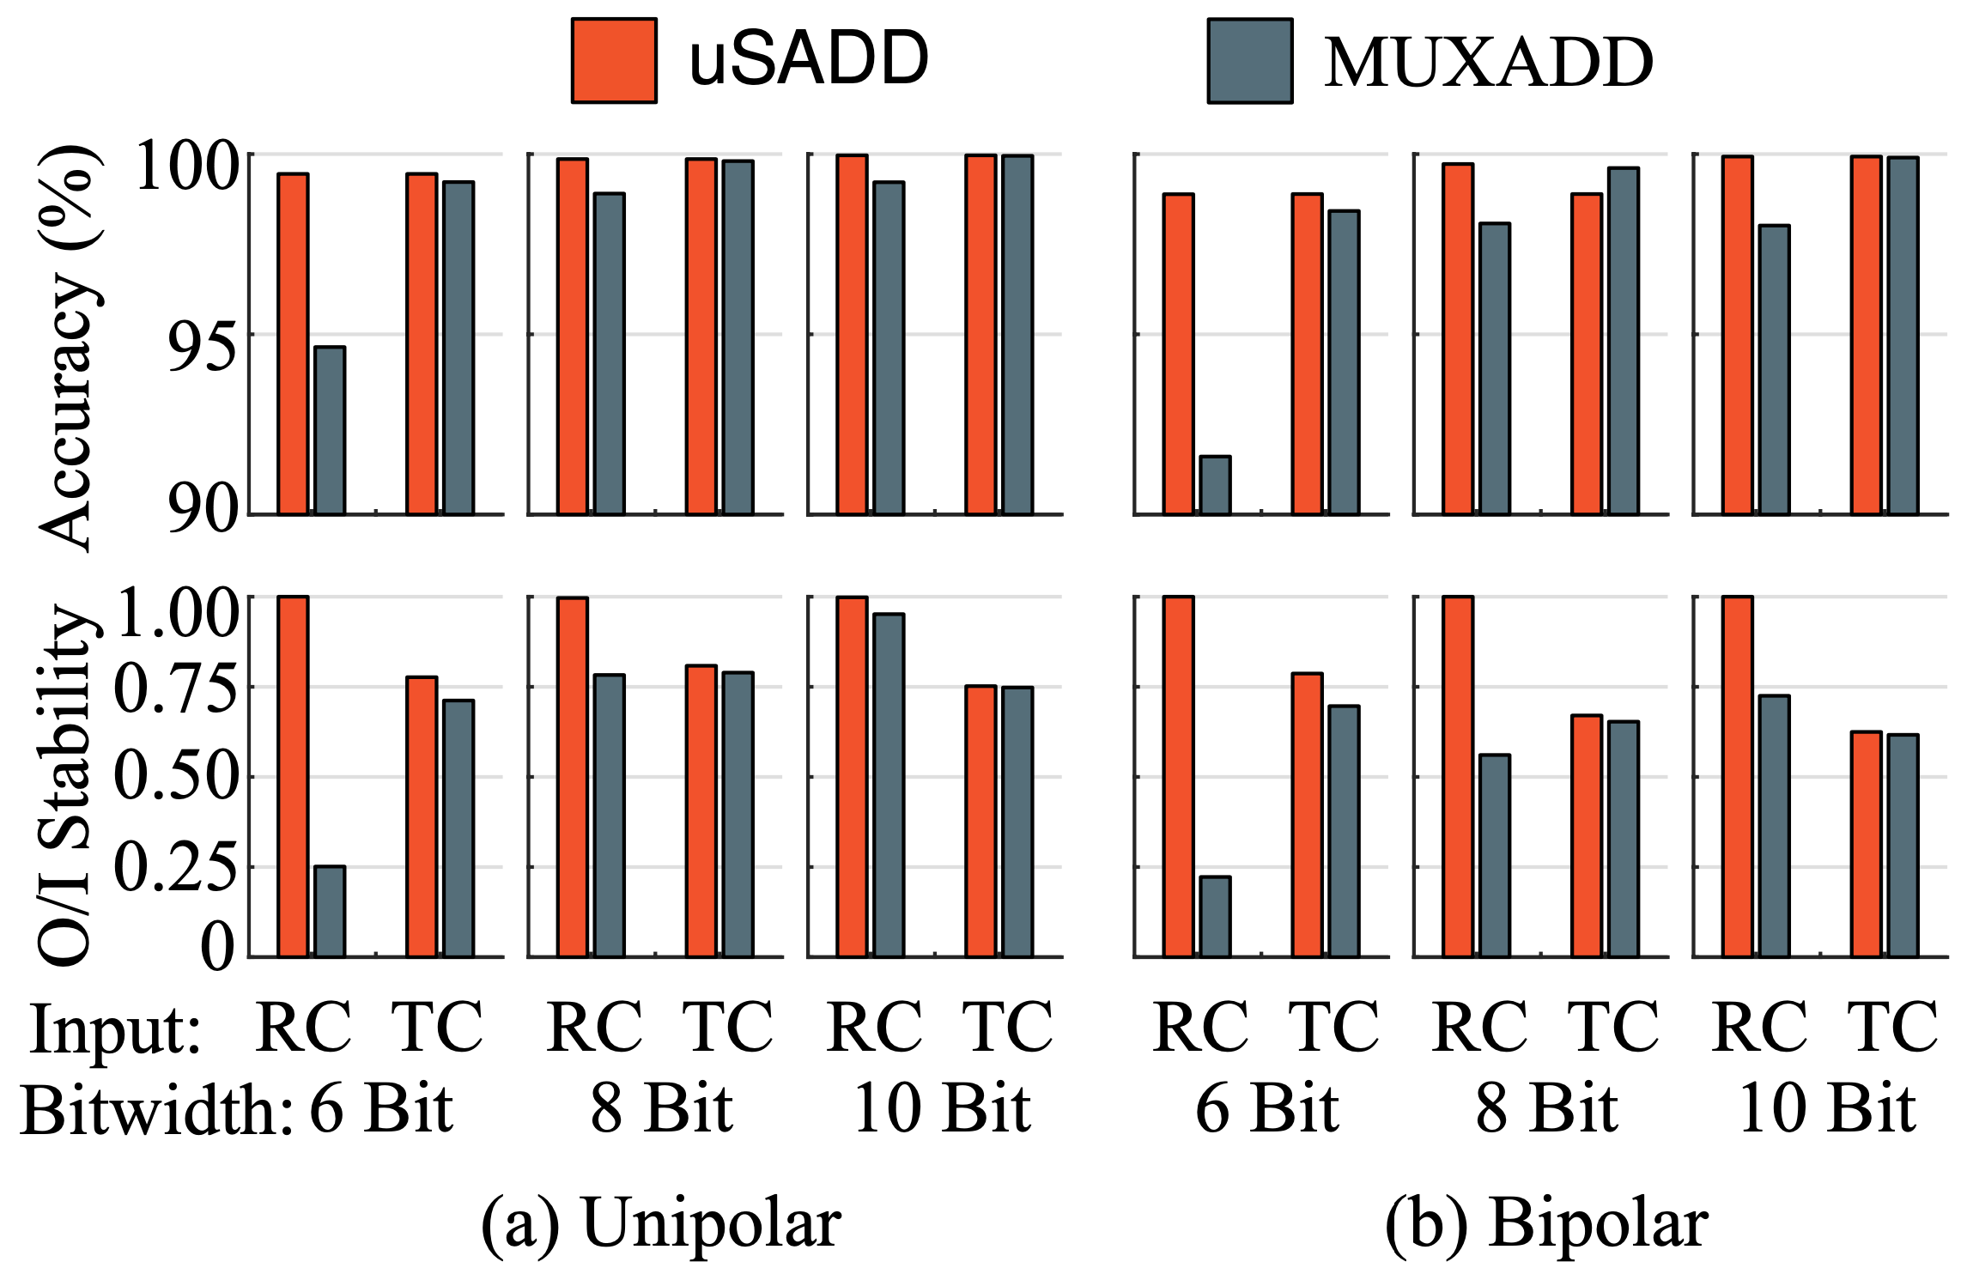
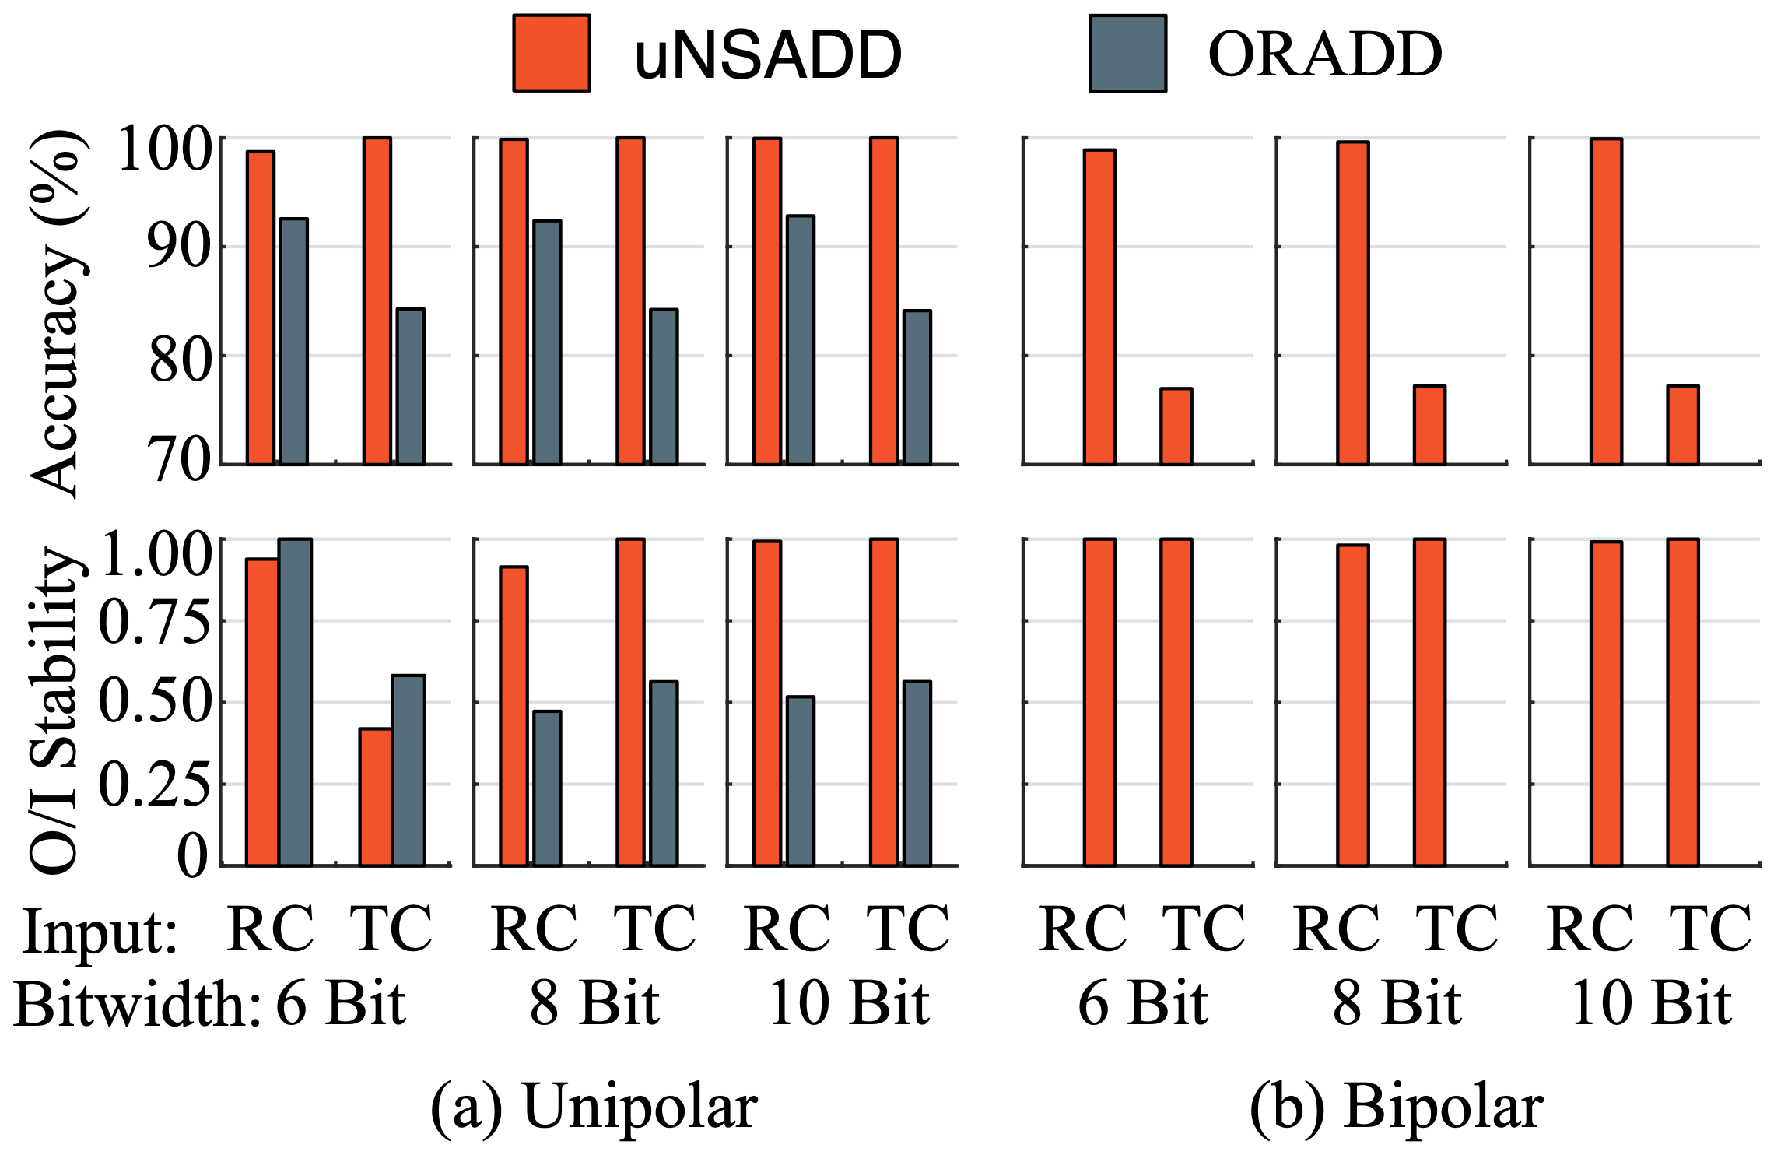
ADD performance: uSADD and uNSADD
Accurate final result
Faster stabilization
Input insensitivity
First to support bipolar non-scaled addition

Slide 53
uGEMM performance
Accurate final result
Cross out all configurations
Computing cycle
Notes:
If you want to go through comparative results, each column comes in one slide (example comparative study for unipolar scaled is in one slide) with one line for takeaway from results. So many graphs on one slide may confuse viewers.

Slide 54
uGEMM performance
Accurate final result
Cross out all configurations
Computing cycle
Notes:
If you want to go through comparative results, each column comes in one slide (example comparative study for unipolar scaled is in one slide) with one line for takeaway from results. So many graphs on one slide may confuse viewers.

Slide 55
uGEMM performance
Accurate final result
Cross out all configurations
Reliable early termination
Earlier stable point
Computing cycle
Notes:
If you want to go through comparative results, each column comes in one slide (example comparative study for unipolar scaled is in one slide) with one line for takeaway from results. So many graphs on one slide may confuse viewers.

Slide 56
uGEMM performance
Accurate final result
Cross out all configurations
Reliable early termination
Earlier stable point
Computing cycle
Notes:
If you want to go through comparative results, each column comes in one slide (example comparative study for unipolar scaled is in one slide) with one line for takeaway from results. So many graphs on one slide may confuse viewers.

Slide 57
uGEMM performance
Accurate final result
Cross out all configurations
Reliable early termination
Earlier stable point
Input insensitivity
Minimal RC/TC difference
Computing cycle
Notes:
If you want to go through comparative results, each column comes in one slide (example comparative study for unipolar scaled is in one slide) with one line for takeaway from results. So many graphs on one slide may confuse viewers.

Slide 58
uGEMM performance
Accurate final result
Cross out all configurations
Reliable early termination
Earlier stable point
Input insensitivity
Minimal RC/TC difference
Computing cycle
Notes:
If you want to go through comparative results, each column comes in one slide (example comparative study for unipolar scaled is in one slide) with one line for takeaway from results. So many graphs on one slide may confuse viewers.

Slide 59
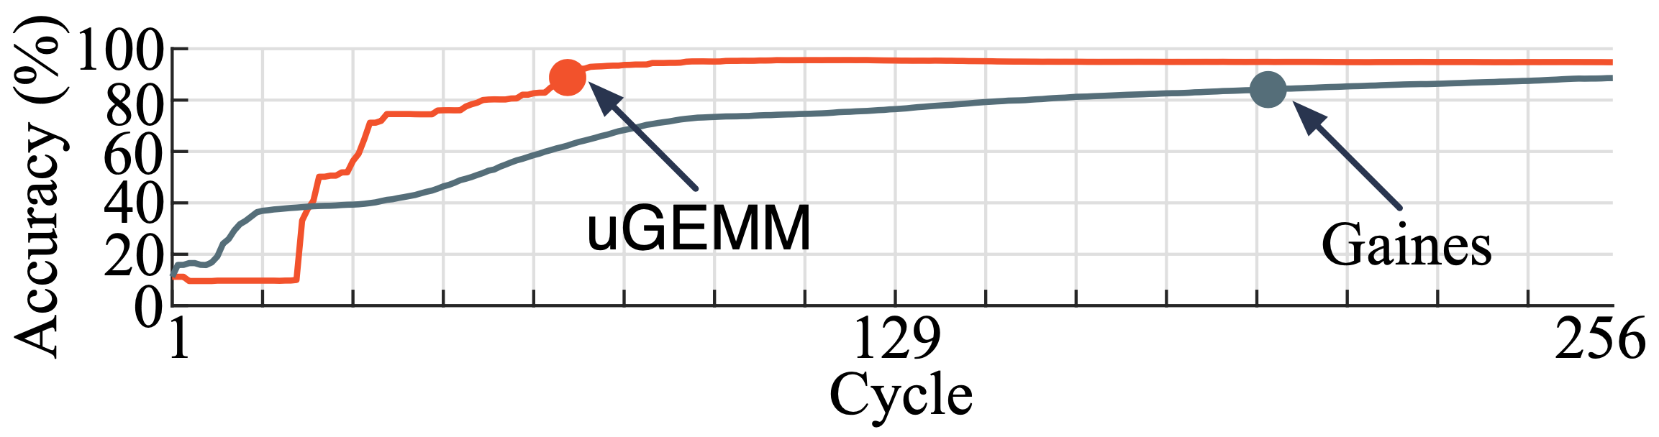
MLP performance
Final accuracy
FP-32bit : 96.87%
FXP-8bit: 96.08%
uGEMM: 94.7%
Gaines: 88.58%
Cycle count for 95% final accuracy
uGEMM: 71
Gaines: 195

Slide 60
uGEMM Energy efficiency
Compared to other unary designs
Higher energy efficiency, though slightly higher area
Compared to binary bit-parallel designs
Comparable for matrix multiplication
10X higher for matrix convolution
Compared to binary bit-serial designs
5X higher for matrix convolution
Notes:
Remove all equations
Add animations
Compare with gaines design for uMUL unipolar (add), and uSADD (mux)
You may get questions as to why higher energy costs for each case.

Slide 61
Thank you!
Q & A

